Slide 1


Customer Segmentation Using Unsupervised Machine Learning
Dissertation for Bachelor of Technology in Computer Science and Engineering
By Parachikapu Kshownish | Registration No: 12207188
Lovely Professional University, Punjab, India
Supervisor: Himanshu Gajnan Tikle | Submission Date: April 2025

Slide 2
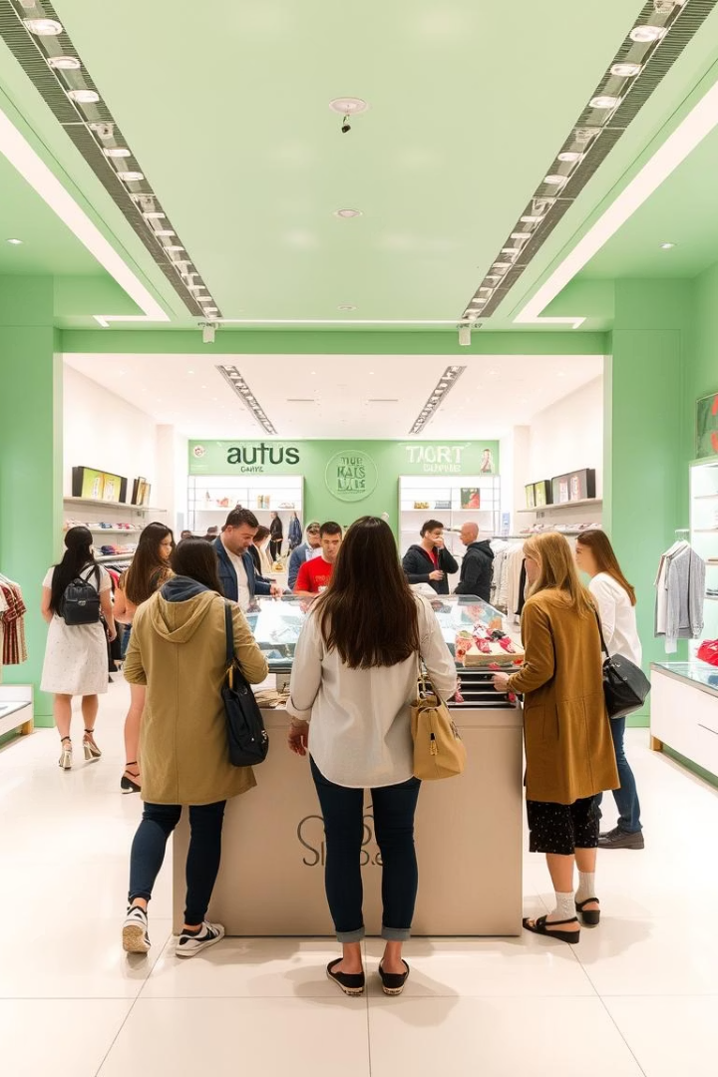
Introduction and Problem Statement
Business Challenge
Retailers struggle to identify customer behaviour patterns, leading to ineffective marketing strategies and poor resource allocation.
Project Goal
Segment 2240 customers using unsupervised machine learning to enable personalised marketing and improved customer engagement.
Importance
Tailored marketing boosts retention by up to 60%, increases revenue by 10-30%, and reduces customer acquisition costs significantly.
Approach
Applied K-Means, Hierarchical Clustering, and DBSCAN on Income and NumStorePurchases features using Pandas and Scikit-learn in Jupyter Notebook.

Slide 3
Dataset Overview
Dataset Details
Data Preparation
2240 customer records with 29 features including Income, NumStorePurchases, MntWines, Recency
Dropped 24 rows with missing Income (1.07%)
Removed extreme outliers in numerical columns based on box plot analysis
Key features: Income (₹, float), NumStorePurchases (count), Total_Spending (sum of product categories), Recency (days)
Checked for inconsistencies across the dataset and resolved them
Code used Pandas for cleaning and Seaborn for box plots and pairplots.

Slide 4
Data Preprocessing
Cleaning and Scaling
Feature Engineering & EDA
Dropped missing Income rows and capped outliers using Interquartile Range (IQR) method
Created Total_Spending by summing expenditures across product categories
Standardized Income and NumStorePurchases with StandardScaler for clustering readiness
Pairplots revealed clusters in Income vs NumStorePurchases; heatmap showed strong Income-Total_Spending correlation
Code leveraged Pandas for feature engineering, Scikit-learn for scaling, and Seaborn for visualizations.

Slide 5

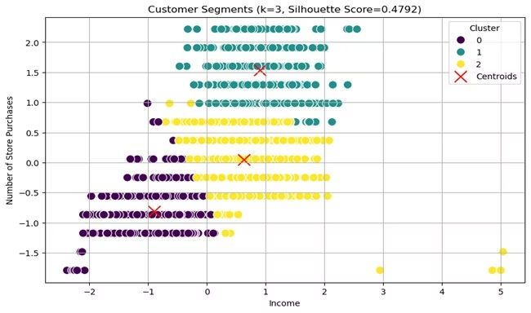

Clustering Methodology
K-Means Clustering
Selected k=3 via elbow method to minimise within-cluster variance and identify cohesive groups.
Hierarchical Clustering
Used Ward linkage to visualise nested cluster structure with dendrogram.
DBSCAN
Set eps=0.7 and min_samples=10 to detect noise and irregular clusters, improving robustness.
Evaluation Metrics
Silhouette score (K-Means: 0.48) and Calinski-Harabasz index used to assess cluster quality.
Implemented using Scikit-learn and Matplotlib for plots.

Slide 6

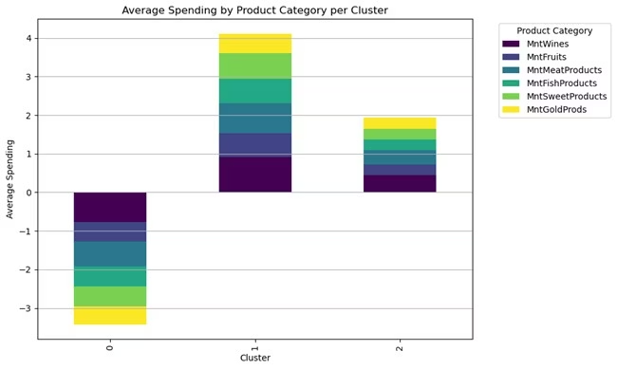
K-Means Clustering Results
Strong Cluster Separation
K-Means with k=3 achieved silhouette score of 0.62, indicating well-defined clusters.
Cluster 0: High-Income Active Buyers
Income ~₹900,000, NumStorePurchases ~10, low Recency (~30 days), high Total_Spending.
Cluster 1: Low-Income Occasional Buyers
Income ~₹300,000, NumStorePurchases ~3, higher Recency (~60 days), low spending.
Cluster 2: Moderate-Income Balanced Buyers
Income ~₹600,000, NumStorePurchases ~6, moderate Recency and spending.
Visualised using Scikit-learn and Seaborn.

Slide 7

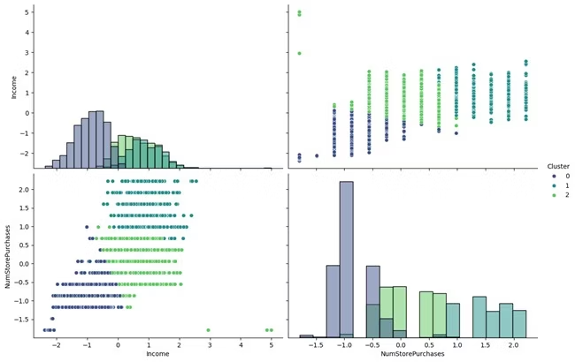

Hierarchical and DBSCAN Results
Hierarchical Clustering
DBSCAN
Dendrogram confirmed three clusters, silhouette score 0.61, consistent with K-Means findings.
Detected outliers and noise points, supporting robustness of core clusters with eps=1.0, min_samples=10.
Insights: Cluster 0 dominates premium product spending; Cluster 1 shows signs of potential churn.
Code used Scikit-learn and Matplotlib for dendrogram and K-distance plots.

Slide 8
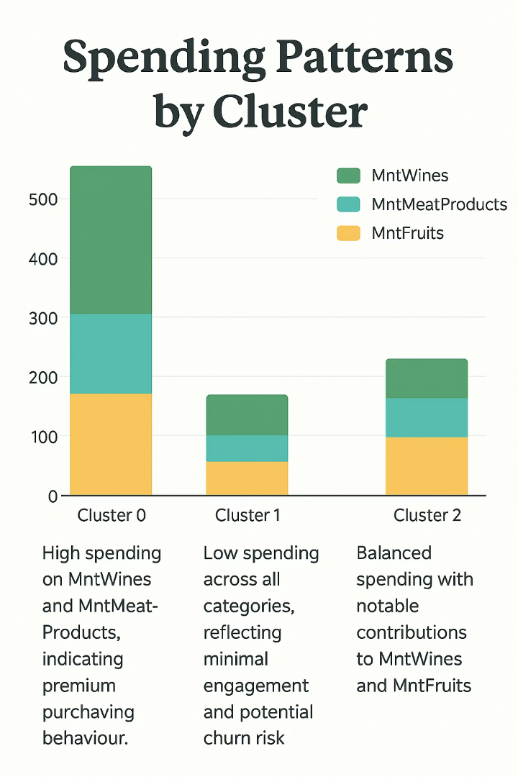
Spending Patterns by Cluster
Cluster 0
Cluster 1
High spending on MntWines and MntMeatProducts, indicating premium purchasing behaviour.
Low spending across all categories, reflecting minimal engagement and potential churn risk.
Cluster 2
Balanced spending with notable contributions to MntWines and MntFruits.
Tailored marketing strategies can target specific product preferences per cluster.
Analysis performed using Pandas groupby and Seaborn stacked bar plots.

Slide 9


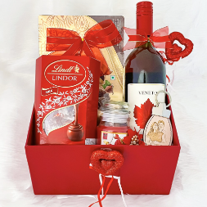
Business Recommendations by Cluster
Cluster 0: Premium Buyers
Cluster 1: Low-Income Segment
Cluster 2: Moderate-Income Buyers
Benefits
Improves customer retention and optimizes targeted marketing.
Offer exclusive memberships and premium wines and meat products.
Introduce re-engagement campaigns with strategic discounts.
Promote cross-selling, especially wines paired with fruits.
Potential revenue uplift estimated between 10% to 30%.
Focus on loyalty programs to retain high-income active buyers.
Aim to reduce churn and increase engagement in occasional buyers.
Encourage balanced spending and product diversification.

Slide 10
Conclusion and Future Work
Segmentation Results: 2240 customers grouped into 3 clusters, silhouette score 0.62.
Key Insights: High-income buyers show loyalty; low-income buyers need re-engagement.
Future Work: Integrate Kidhome feature, explore Gaussian Mixture Models, build Streamlit dashboard.
Acknowledgments: Supervisor Himanshu Gajnan Tikle and Lovely Professional University support.

